Slide 1

Meeting will start at 16:30
General Assembly
2022/23

Slide 2

Helping new
talent into
the tech world

Slide 3
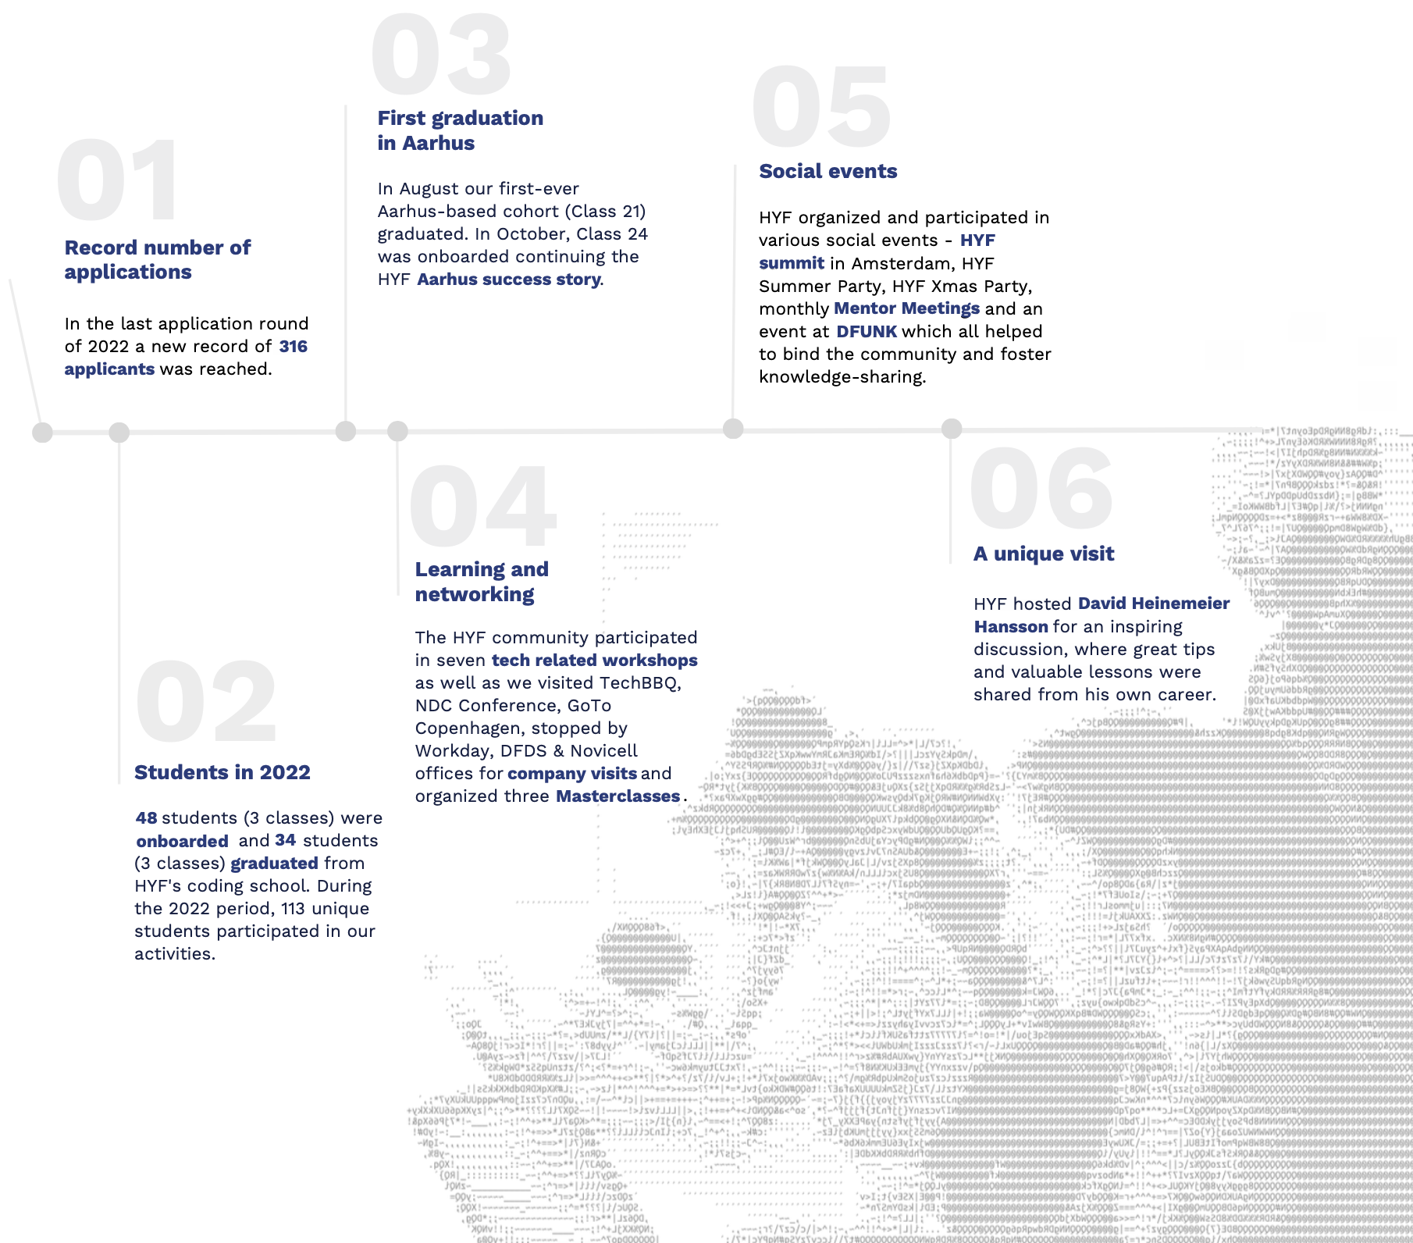

Slide 4
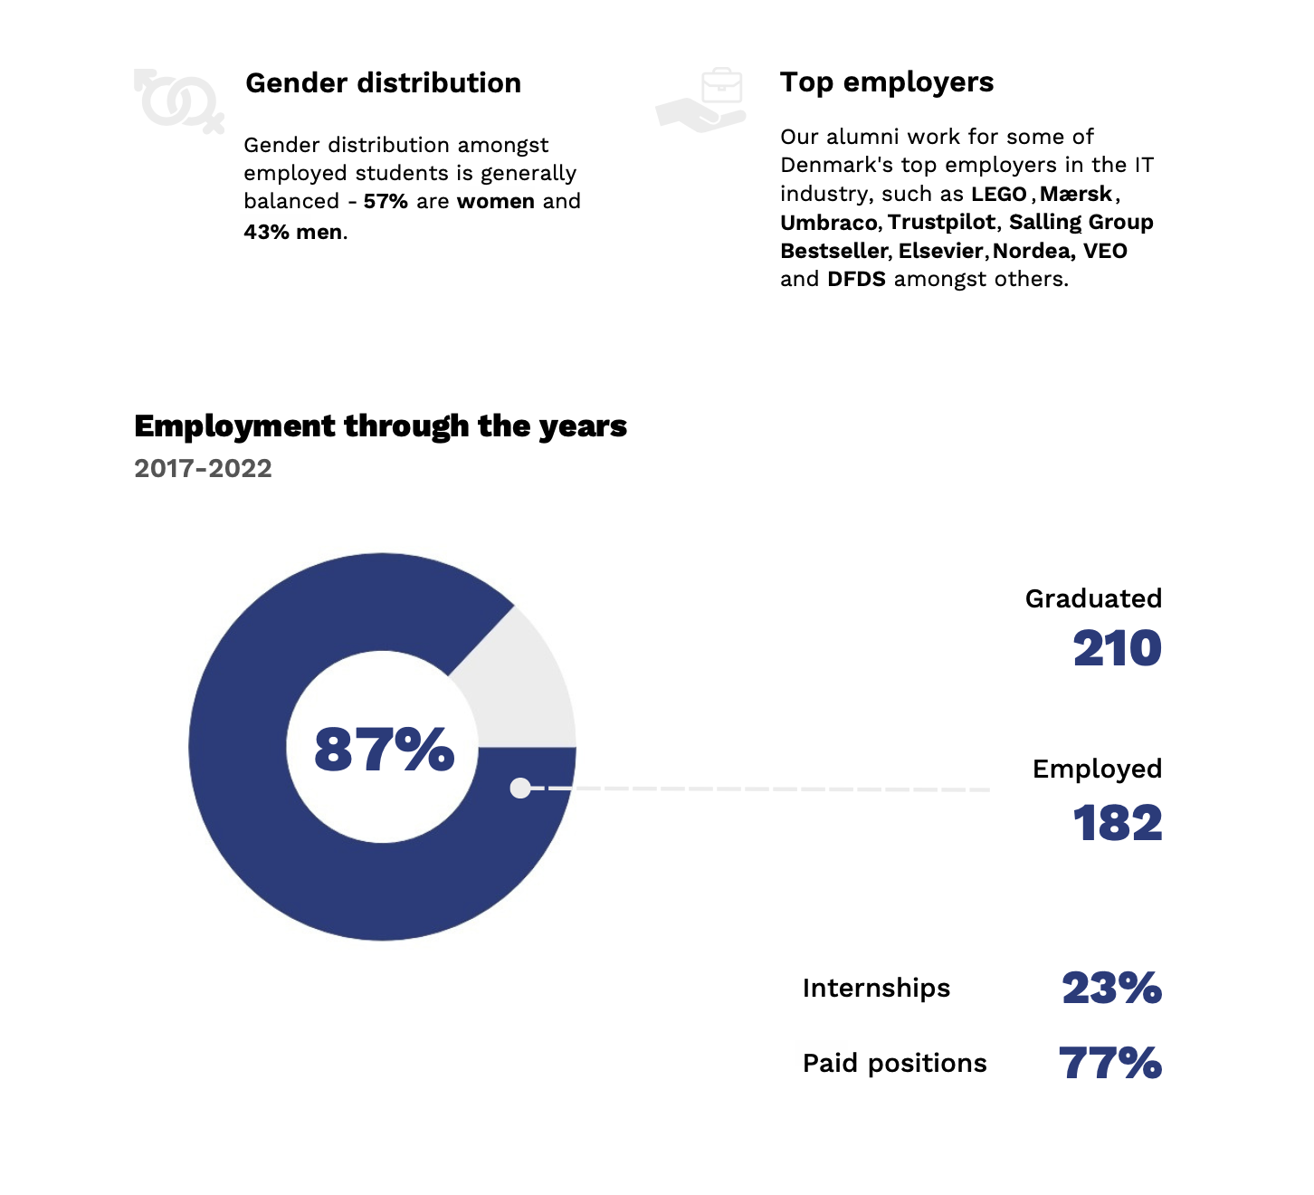


Slide 5
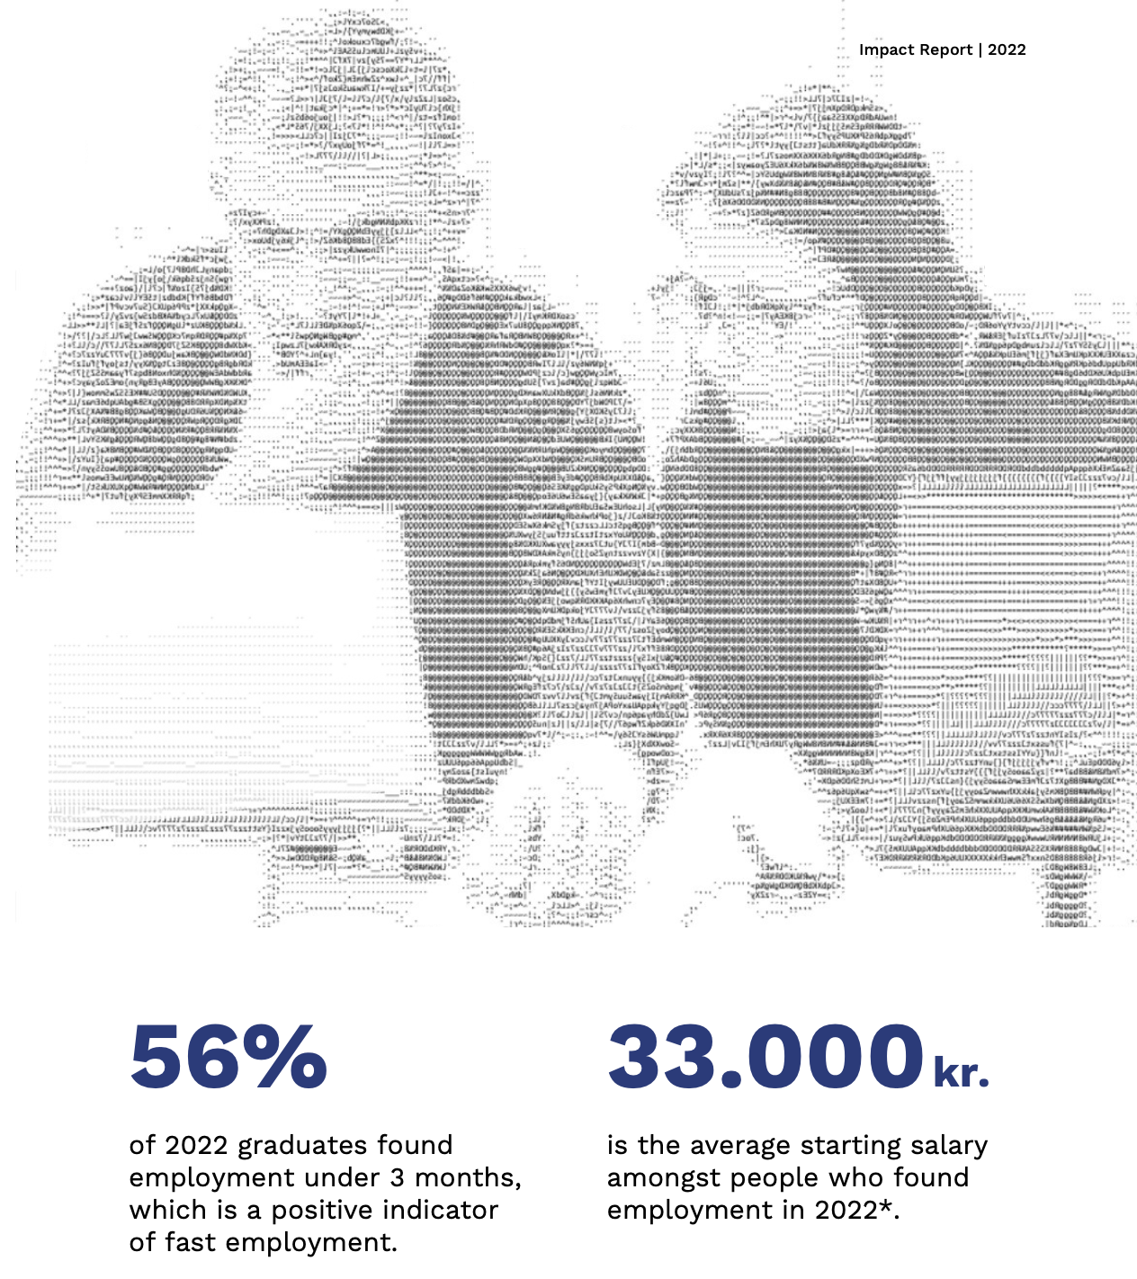
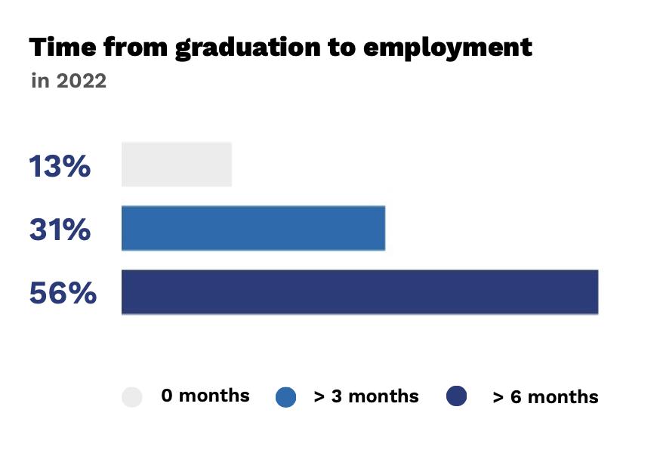

Slide 6
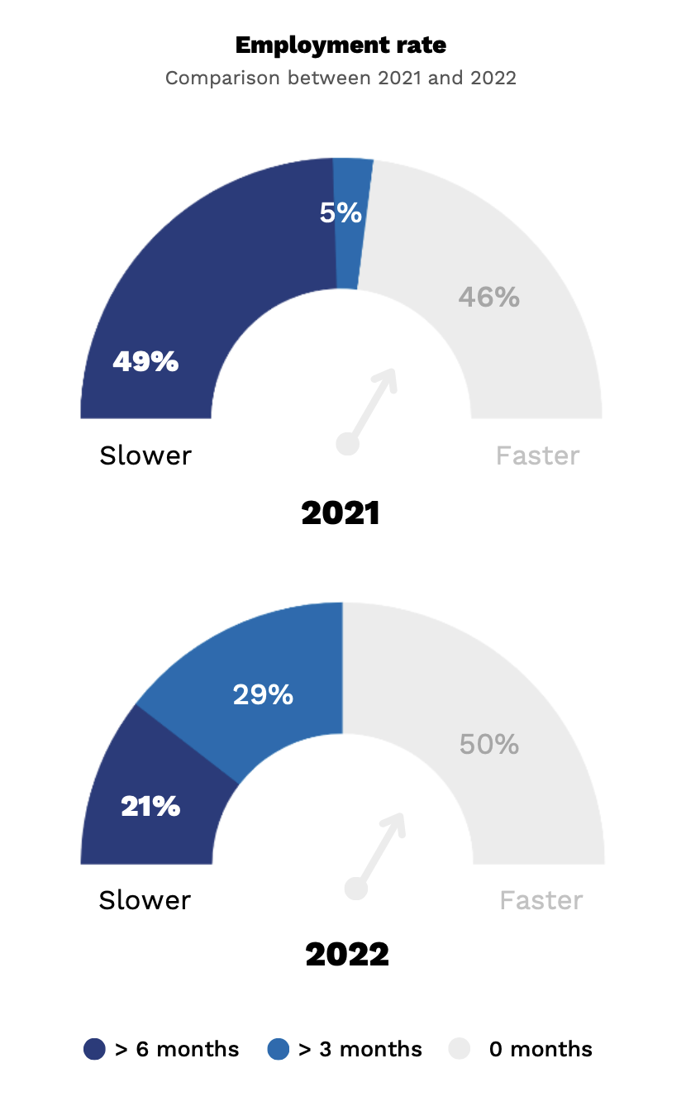

Slide 7

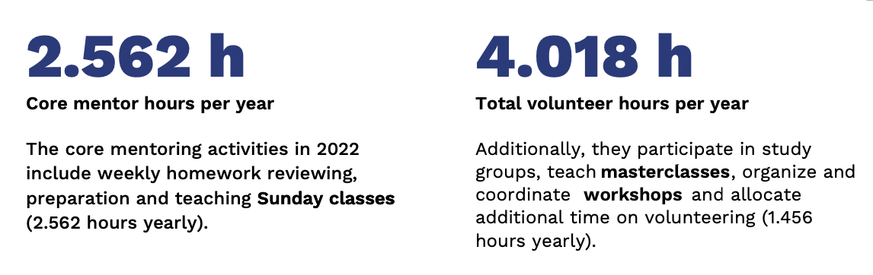

Slide 8
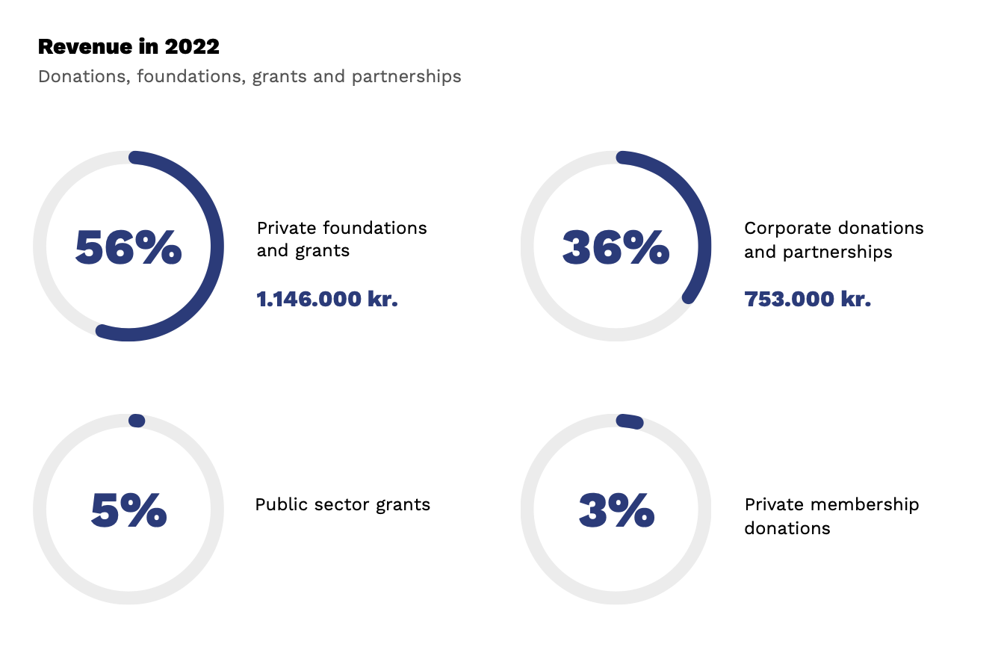

Slide 9
Agenda
1. Election of teller
2. Election of moderator and secretary
3. Report by management
4. Accounting
5. Consideration of proposals
6. Approval of the budget
7. Election of chairperson
8. Election of vice chairperson
9. Election of treasurer
10. Election of additional board members
11. Election of auditor
12. Miscellaneous

Slide 10
Election of teller
1.

Slide 11
Election of moderator & secretary
2.

Slide 12
Report by management
3.

Slide 13
Accounting
4.
Notes:
https://docs.google.com/spreadsheets/d/1gz_aQoWPoBZVjQuknSc6W7n0E8cWo4h0/edit?pli=1#gid=1617071392

Slide 14
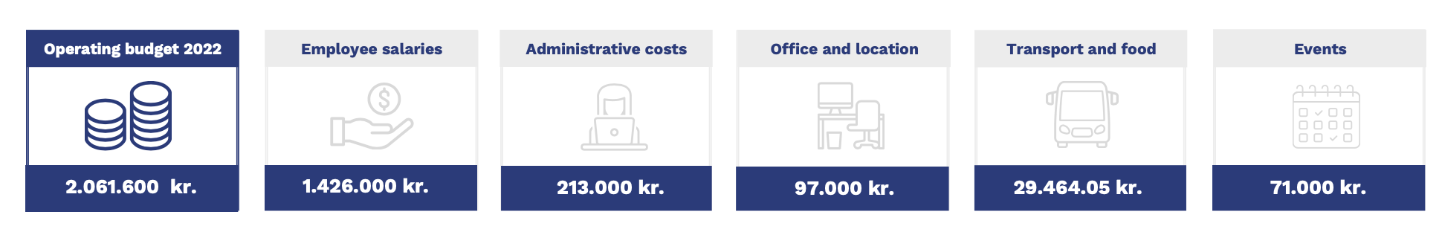

Slide 15
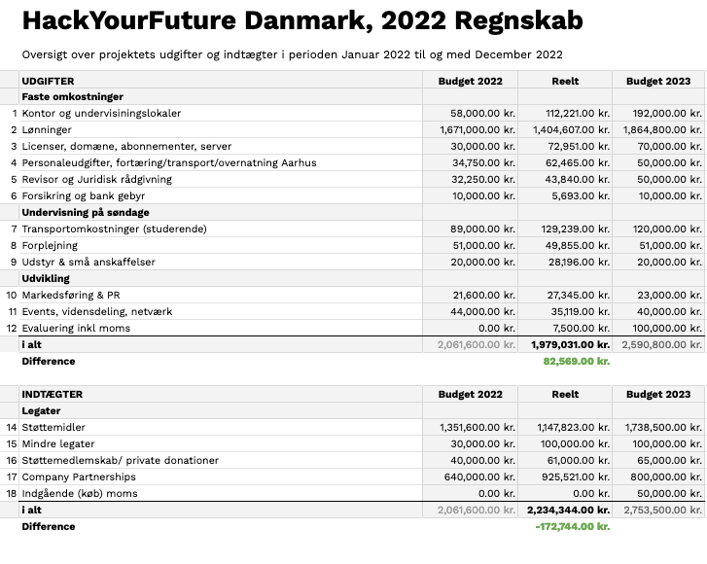

Slide 17
Consideration of proposals
5.

Slide 18
Approval of the budget
6.

Slide 19
Election of chairperson
7.

Slide 20
Election of vice chairperson
8.

Slide 21
Election of treasurer
9.

Slide 22
Election of additional board members
10..

Slide 23
Miscellaneous
11..

Slide 24















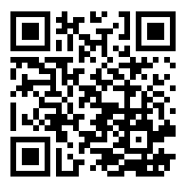














Follow our
progress on
social media
www.hackyourfuture.dk
Gold Partners:
Partial funding:
Silver Partners:
Support our work:
Bronze Partners:
Evaluation by:

Slide 25
Bye Bye

